Slide 1


MACHINE LEARNING
HACKATHON
Submitted By Team Data Visionaries – Anita Panda, Bharti Moudgill,Dattatray Chobhe, Dheeraj Dua, Divesh Gandhi
BM

Slide 2


Problem Statement
To Predict if a customer is going to accept a coupon for a particular venue, considering demographic and contextual attributes
• train data - 10,147 records
• test data – 2,537 records
The aim is to build a robust model to determine whether a customer will accept coupon for a particular venue or not

Slide 3
Approach
5. Outlier & Skewness Treatment
1. Problem Statement
Approach
6.Data Analysis
2. Approach
7.ML Modelling
3.Challenges
4.Treatment of Missing Value
8. Business Insights

Slide 4

Challenges
Missing values in 5 features
Multiple labels in categorical features with different names meaning the same thing
Presence of Outliers
Complex relationship between different features

Slide 5
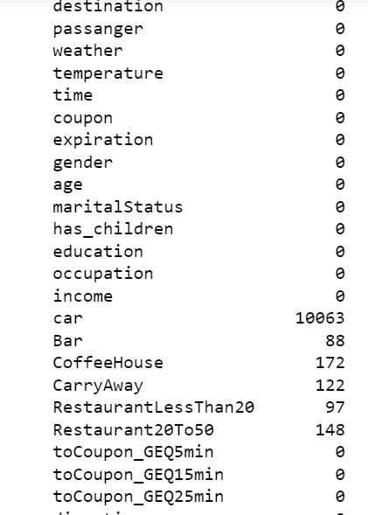
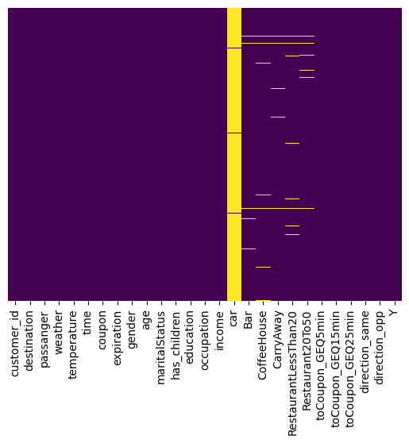
Treatment of Missing Values
Car – There are 84 values only out of 10147 in this column which is less then 1% hence we removed this column as it has no impact.
Bar, Coffee House, CarryAway, RestaurantLessThan20, Restaurant20To50 – These have missing values around 2% hence we have used the Feature engineering technique to fill the most commonly occurring value out of the total values available in these columns.

Slide 6
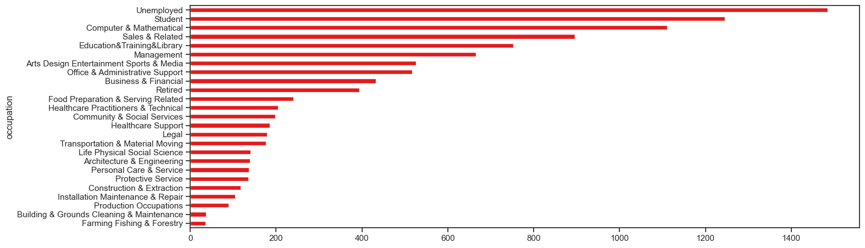
Outlier & Skewness Treatment
Occupation column has 25 labels and the data frequency variation is very high creating outliers and skewness, so we used the Binning technique to reduce the number of labels hence removed the outliers and skewness

Slide 7
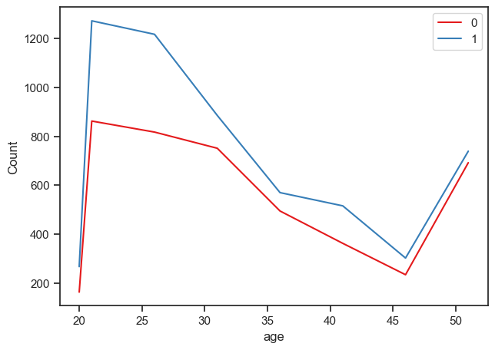
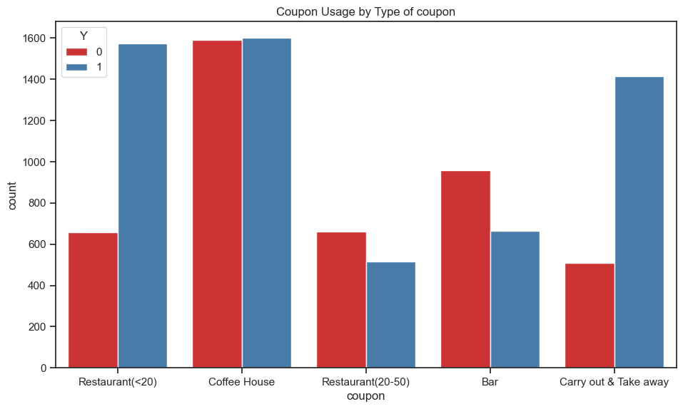
Data Analysis
Age Vs Coupons(Historical Data)
Age group from 21 to 35 the coupon usage is very high. Below 21 years the coupon distribution is low and hence the usage
Success of Coupons (Historical Data)
Carry out and Take Away and Restaurant(<20) were the most successful coupons

Slide 8
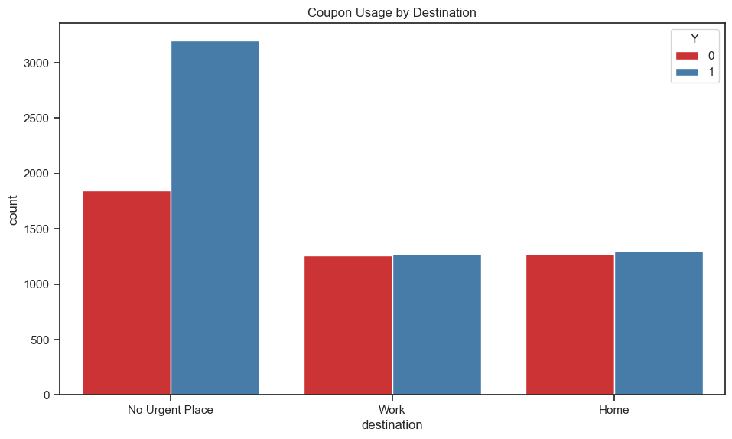
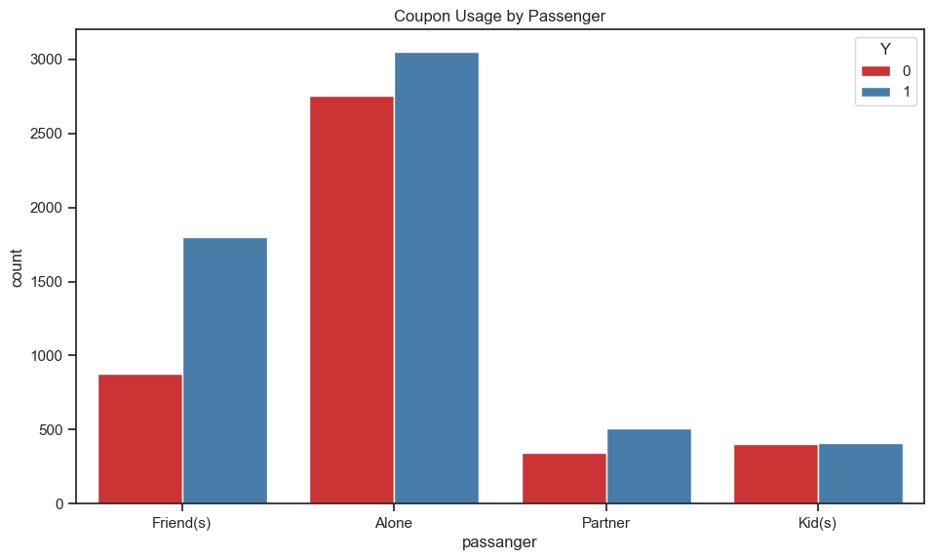
Data Analysis
Destination Vs Coupons(Historical Data)
Coupon usage is the highest for No Urgent Place
Passenger Vs Coupons(Historical Data)
Alone Passengers have the highest Coupons usage

Slide 9
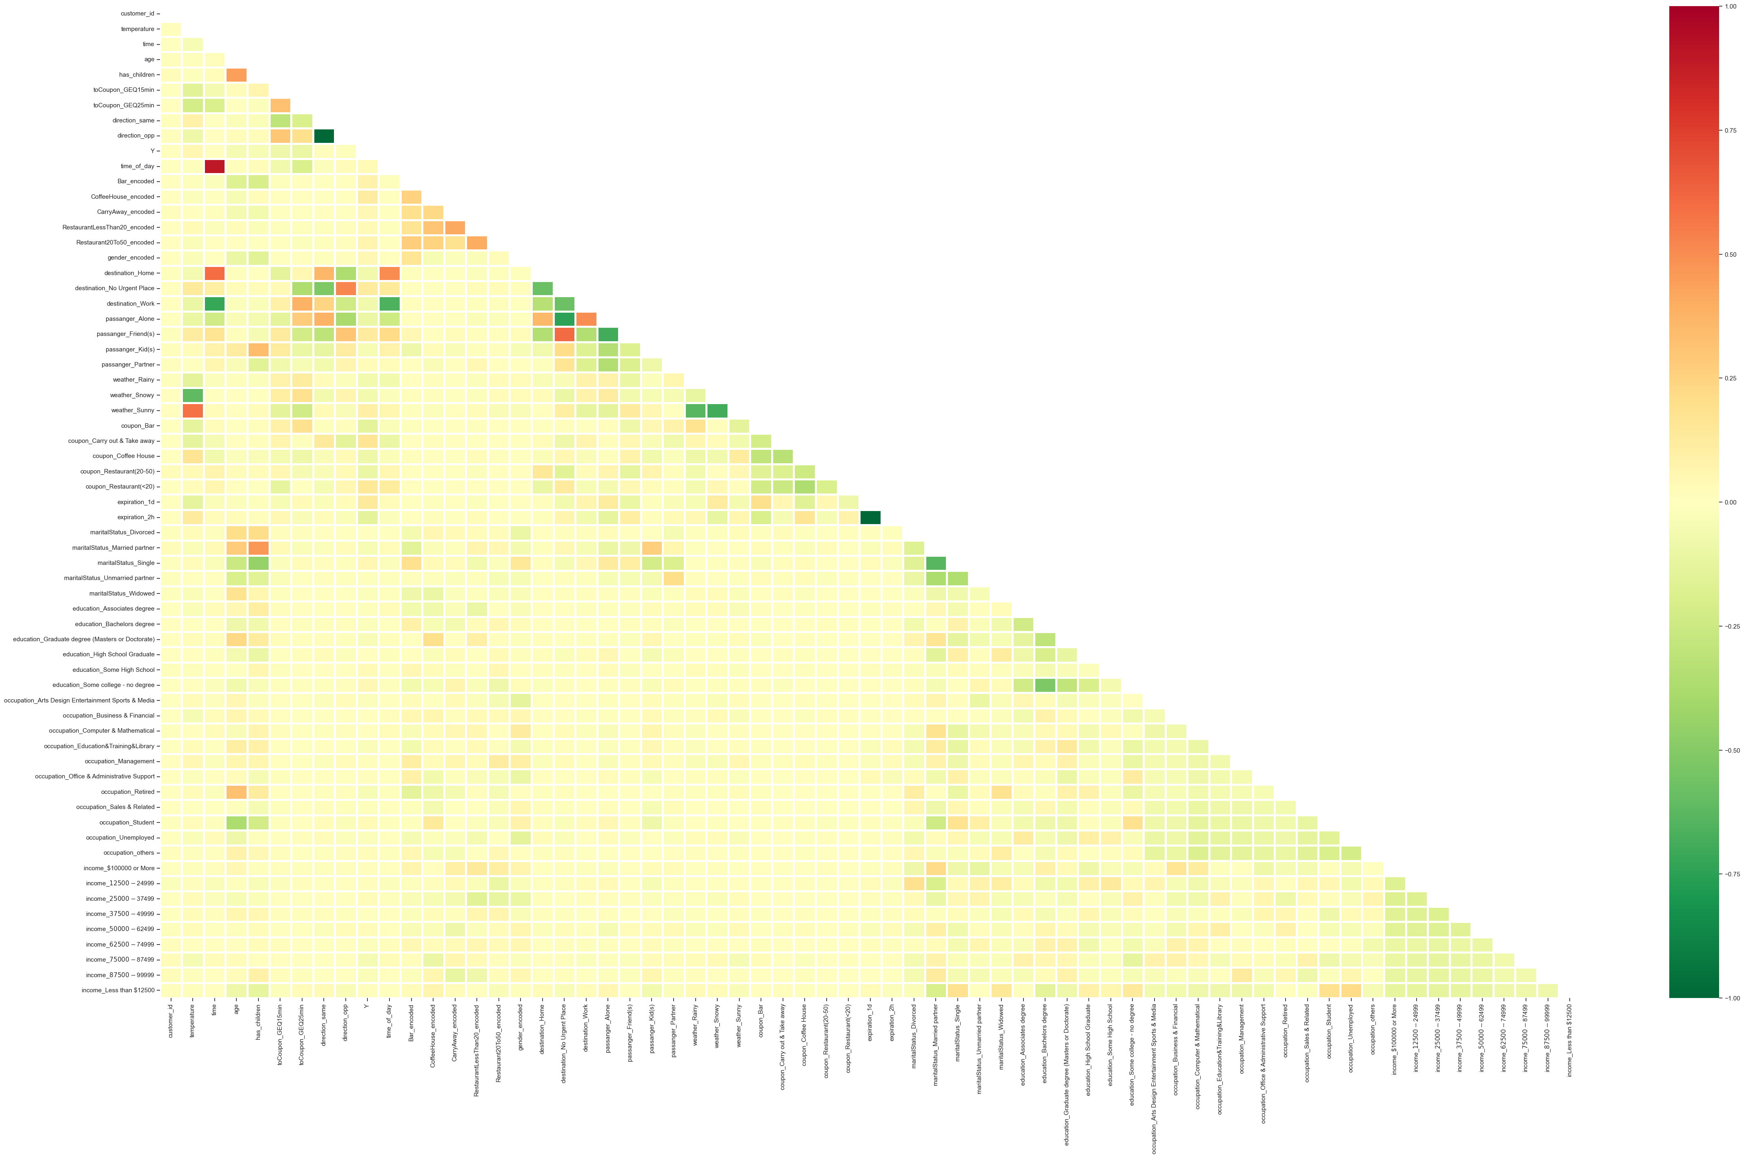
Pre Processing
Multicollinearity Chart
Colour Legend
Yellow shade – Correlation is 0
Red and Dark Green is -1 and +1
Actions taken basis observations for Preprocessing
In the analysis we have used the Pearson method hence the values which are in between -1 and 1, hence all the# columns with 0 values can be removed based on the collinear relationship# Based on the analysis, we can remove the columns 'customer_id', 'temperature', 'time',# 'weather_Rainy','weather_Snowy', 'weather_Sunny’
Removed low-information variables - toCoupon_GEQ5min
Remove low-information variables - car with 99.2% blank values
Age column categorized in such a way where values less than 20 and greater than 51 were clubbed in different categories
Imputed missing values for 'Bar', 'CoffeeHouse', 'CarryAway', 'RestaurantLessThan20', 'Restaurant20To50’ into mode (most frequent value)
Time converted to Integer values by using date time format
Normalized and Converted age to numerical data type
Removed outlier and skewness in occupation column

Slide 10
Machine Learning Modelling
ML Model 1: Random Forest
ML Model 2: XGBoost
ML Model 3: CatBoost
Random
Forest
Hyper Tuning
Cross
Validation
Accuracy Score
75.91%
XG Boost
Hyper Tuning
Cross
Validation
Accuracy Score
76.78%
CatBoost
Hyper Tuning
Cross
Validation
Accuracy Score 77.45%
ML Models with highest accuracy scores

Slide 11
Business Insights
Advantages to Business
Coffee, Restaurant (<20) and Take away coupons are more successful
Coupons are mostly used by age group 21 to 35 years
Weather has an impact on coupon usage as sunny weather favors it.
Computer Workers, Retired, students and Unemployed are mostly using the coupons
Customers tend to use the coupons mostly when the weather is sunny
Carry away coupons utilization is most for customers using it 1~3 times in a month
Coupon_GEQ5min is dropped as its a low information column
Highest No of Coupon Acceptance for driving distance >15 mins

Slide 12
Thank You

